Slide 1

From code to cloud automating frontend deployments with Terraform

Slide 2

Agenda

Slide 3

Agenda

Slide 4

Agenda

Slide 5
Streamline Your Deployments: Full Automation in Focus
Today, we’ll uncover strategies to simplify complexity and achieve consistent, fully automated deployment of your entire application infrastructure and application.

Slide 6
Agenda
What’s Terraform
Run Terraform locally.
Professional architecture
Tips and tricks

Slide 7

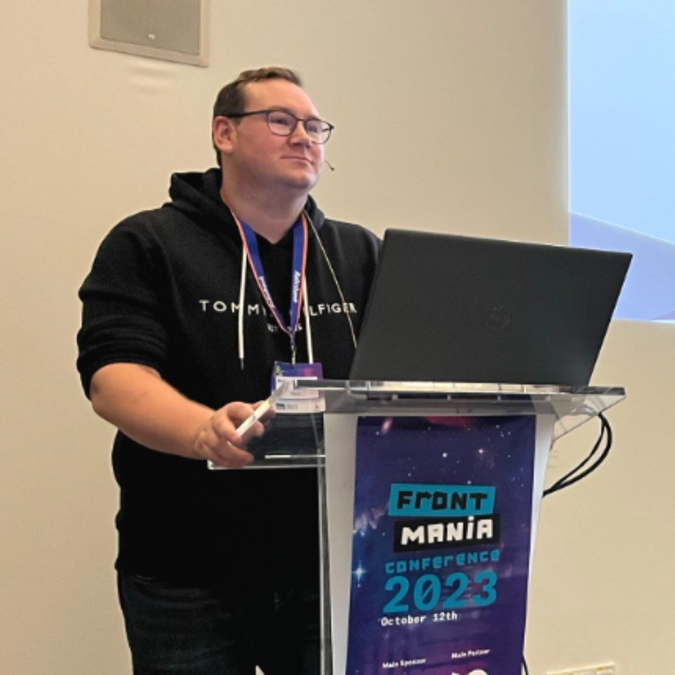
Rodney Wormsbecher @ Ordina a Sopra Steria Company
https://www.linkedin.com/in/rocodemy

Slide 8
What’s terraform?

Slide 9
What is Terraform?
Terraform is a tool that simplifies the management and setup of infrastructure, such as servers, databases, and networks, required for your applications to run. Think of it as a blueprint for efficiently creating and maintaining cloud resources.

Slide 10
How does it work?
Write configuration files in HCL to describe your infrastructure:
A server
A database
Communication between them
Terraform builds and manages these resources for you.

Slide 11
The developer process
The Terraform workflow typically involves three steps:
Code / Init: Initialize terraform.
Plan: Preview the changes Terraform will make.
Apply: Execute the plan to provision your infrastructure.

Slide 12
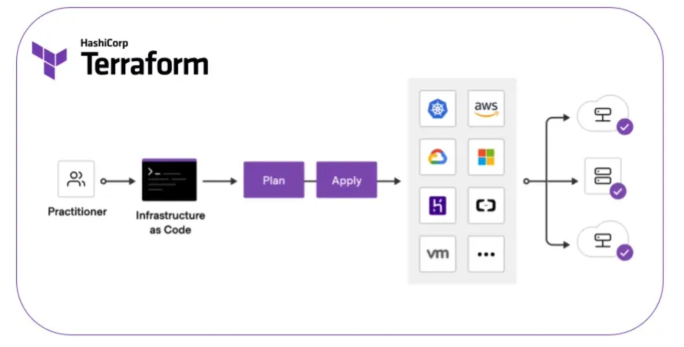
The developer process

Slide 13
Terraform commands
terraform init
terraform plan -out=plan.tfplan
terraform apply "plan.tfplan"

Slide 14
Run Terraform locally

Slide 15
Getting Started with Terraform
Download the Terraform Executable You can download the Terraform binary from: https://developer.hashicorp.com/terraform/install

Slide 16
Setup Terraform
Unzip the Package Extract the downloaded file.
Place the Executable Move terraform.exe to a dedicated folder on your disk.
Remember the Path Save the folder path — you'll need it for the next steps.

Slide 17
Configure environment variables
Navigate to System Settings
Go to System → Advanced System Settings → Environment Variables.

Slide 18
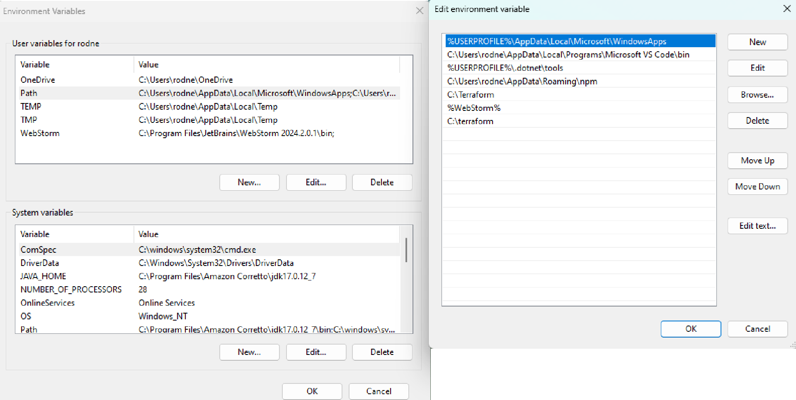
The commands

Slide 19
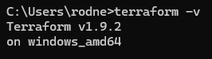
Verify the installation
To ensure Terraform is installed correctly, run the following command in your terminal.

Slide 20
Run Terraform locally
Create a Folder On your system, create a new folder for your Terraform project.
Create the Main File Inside the folder, create a file named main.tf.

Slide 21
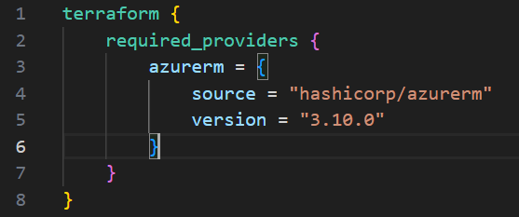
Run Terraform locally
Begin by configuring the provider in the main.tf file. For example, to use Azure we can use hashicorp/azurerm

Slide 22
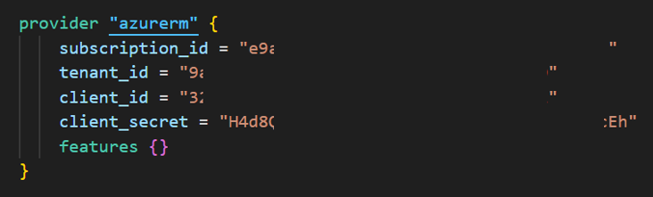
Run Terraform locally
Next we will set up a provider for azurerm.

Slide 23
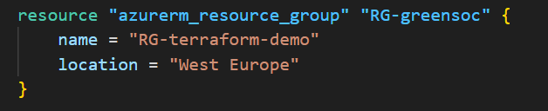
Run Terraform locally
Now that the provider is set up, we can define the code to create a resource group in Azure

Slide 24
Run Terraform locally
Run the following commands to initialize and plan your Terraform setup:
terraform init
terraform plan --out=plan.tfplan

Slide 25
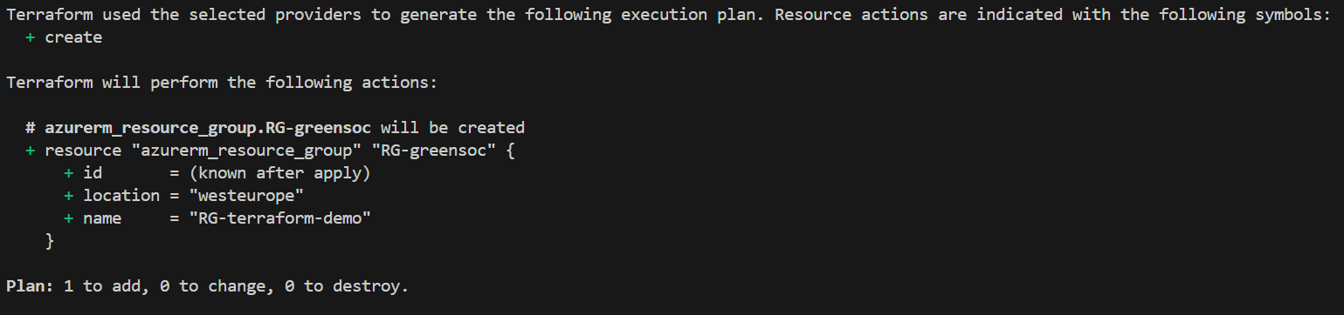
Run Terraform locally
You will see the current changes for terraform. If the changes look correct, proceed with applying the plan

Slide 26
Run Terraform locally
You can apply the plan by running:
terraform apply "plan.tfplan"

Slide 27
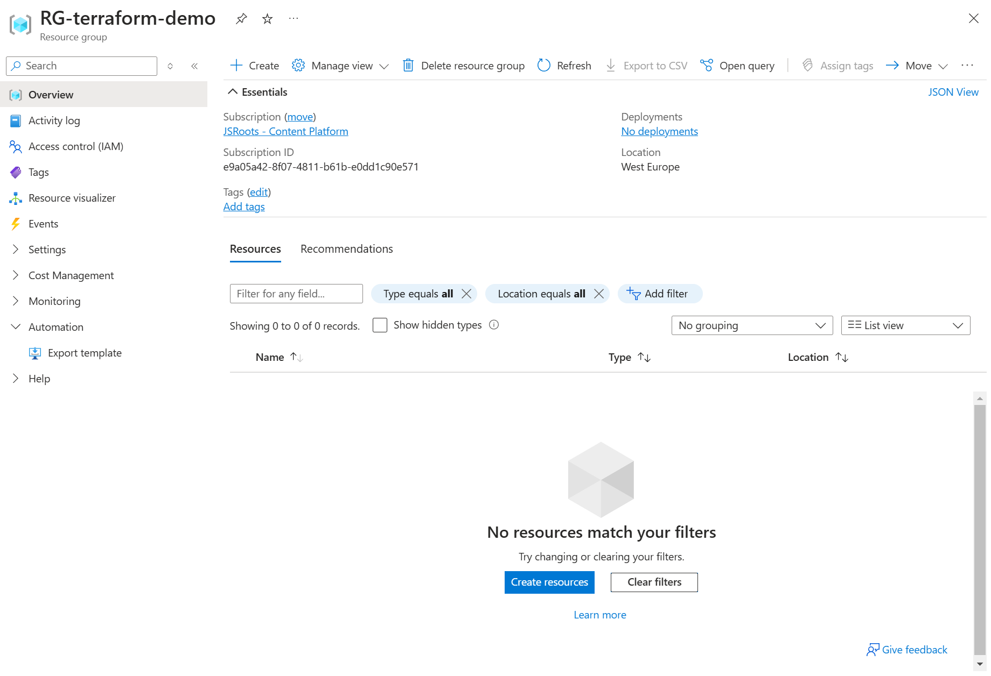
Run Terraform locally
Let’s apply the plan by running:

Slide 28
Run Terraform locally
Resources in most cloud providers incur costs. It’s important to know that Terraform can also destroy resources when they are no longer needed.
Terraform destroy

Slide 29
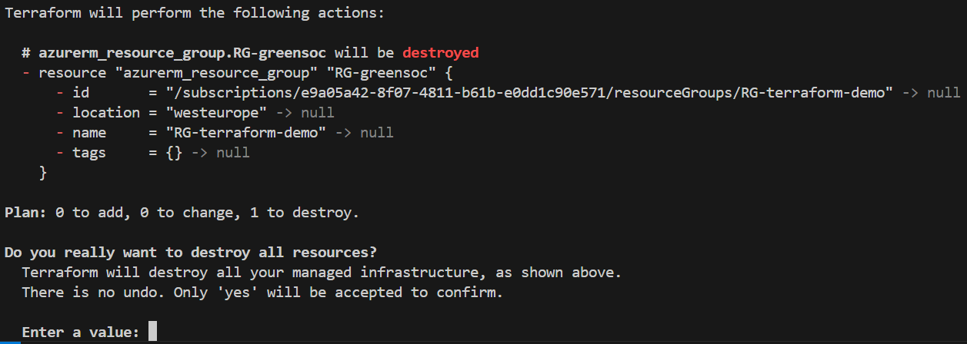
Run Terraform locally

Slide 30
Run Terraform locally
If everything works correctly, the resource group will be deleted from Azure, as shown below: The infrastructure is successfully cleaned up.

Slide 31
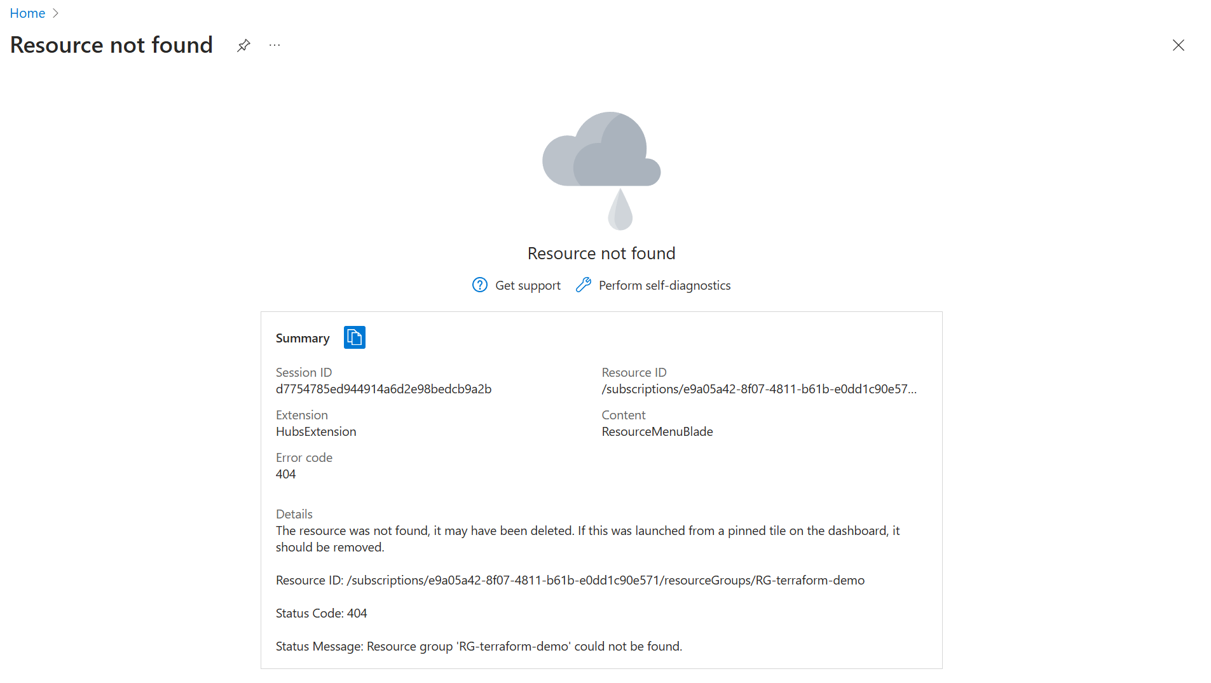
Run Terraform locally
If you refresh the page you will now see:

Slide 32
Professional architecture

Slide 33
Professional Terraform architecture
Now that we have a clear understanding of how Terraform works, let’s look at a more professional architecture.

Slide 34
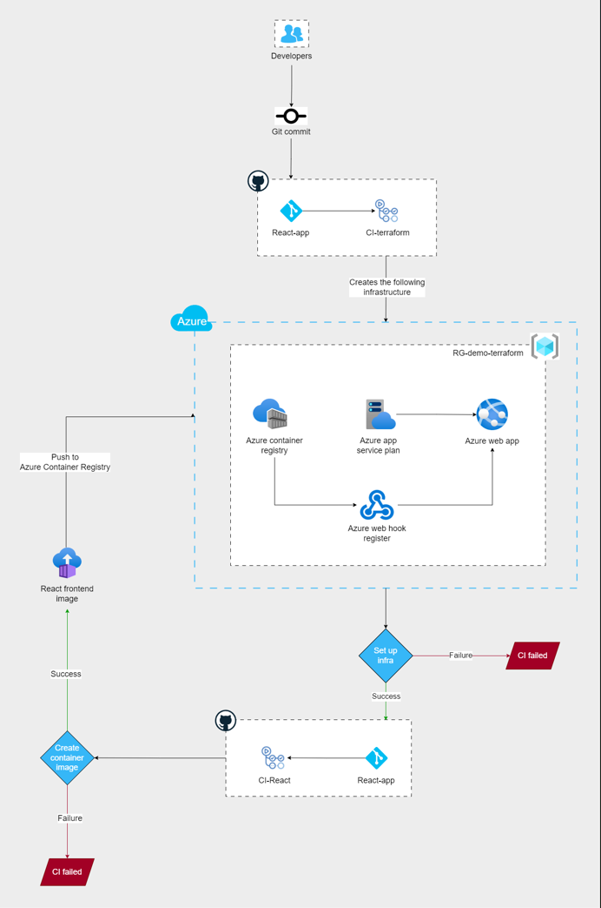

Slide 35
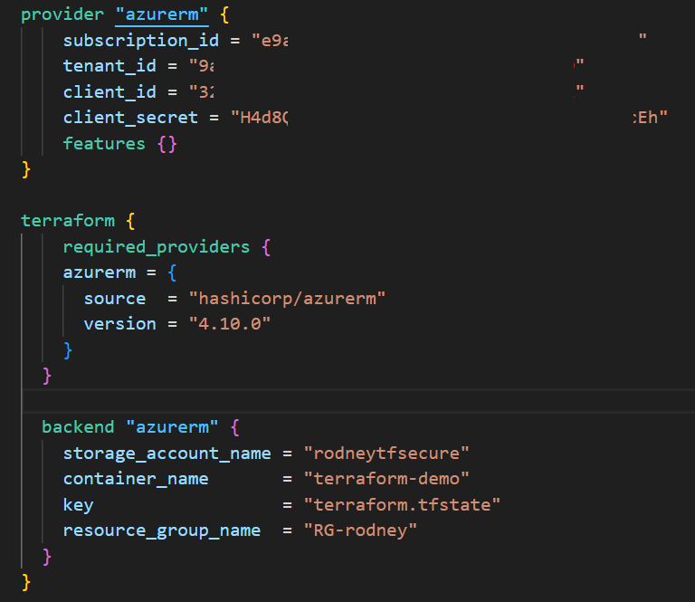

Slide 36
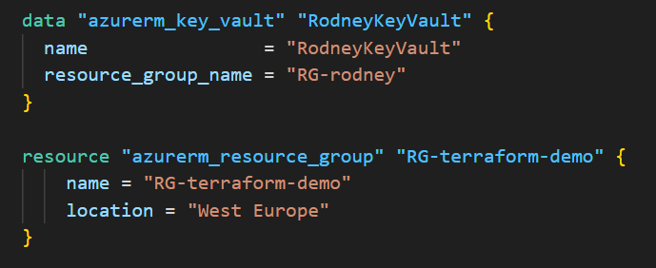

Slide 37
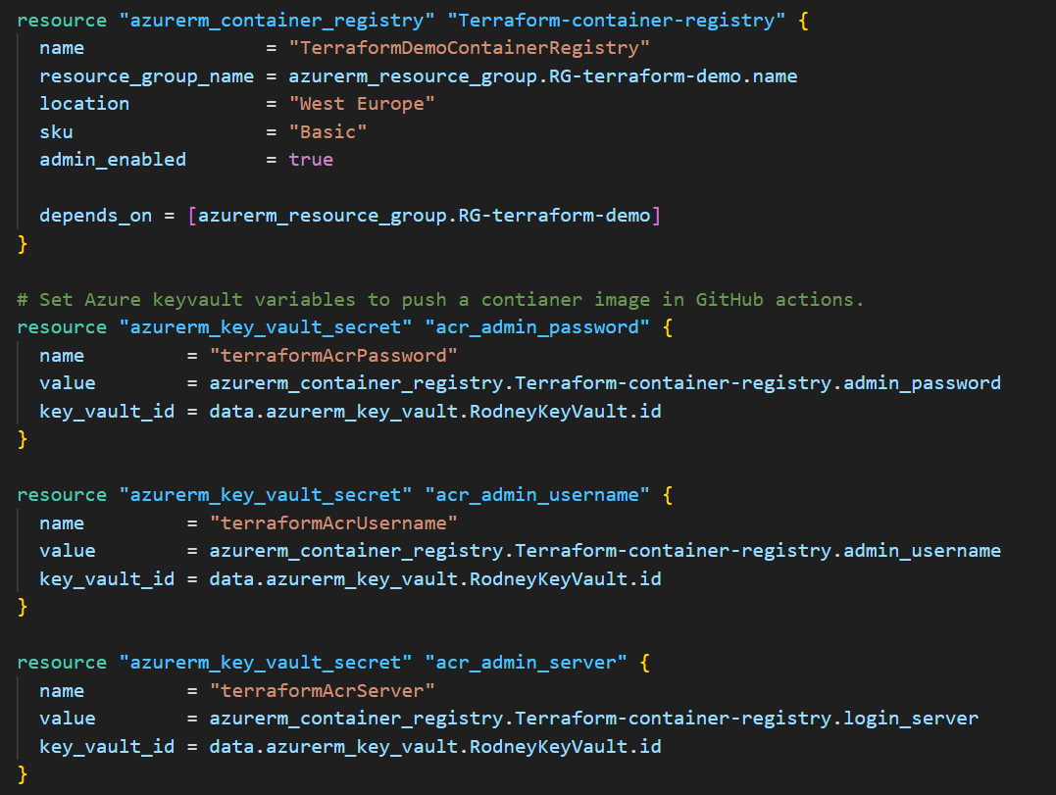

Slide 38
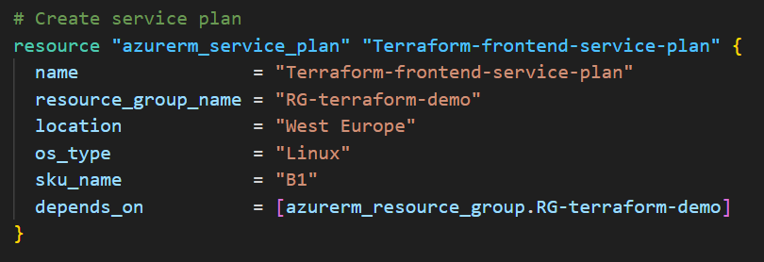

Slide 39
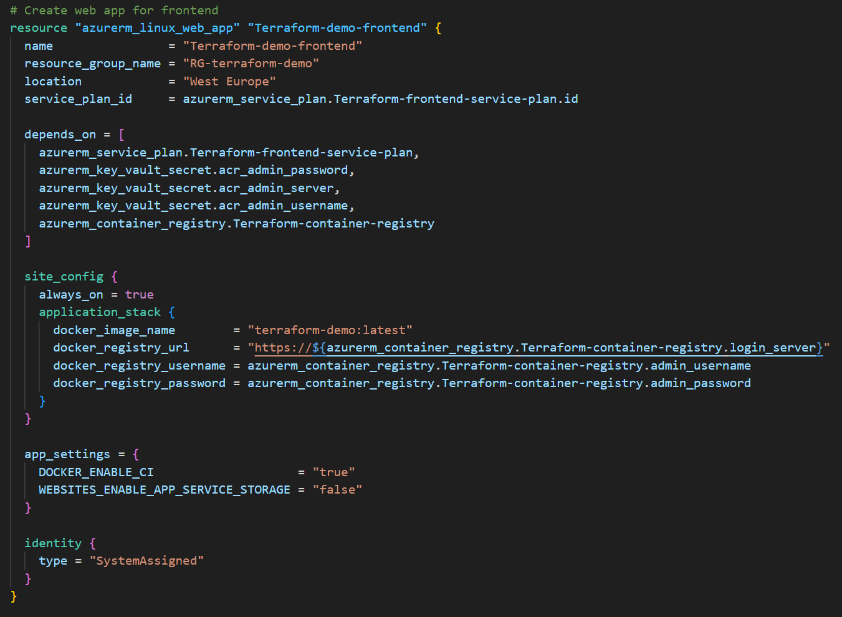

Slide 40
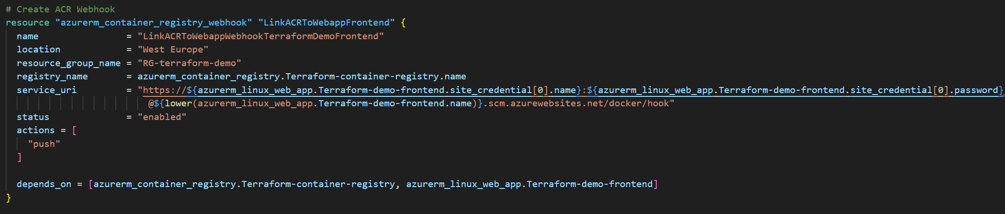

Slide 41
Professional architecture
With the terraform configuration out of the way we can create our infrastructure whenever we deem to. All we need to do is:
terraform plan -out=plan.tfplan
terraform apply "plan.tfplan"

Slide 42
Connecting to CI/CD
Let’s connect CI/CD to trigger Terraform everytime a commit or pull request is done.

Slide 43
Terraform CI/CD
We need to do the following steps:
Checkout repo
Install terraform
Log into Azure Container Registry.
Plan and apply Terraform.

Slide 44
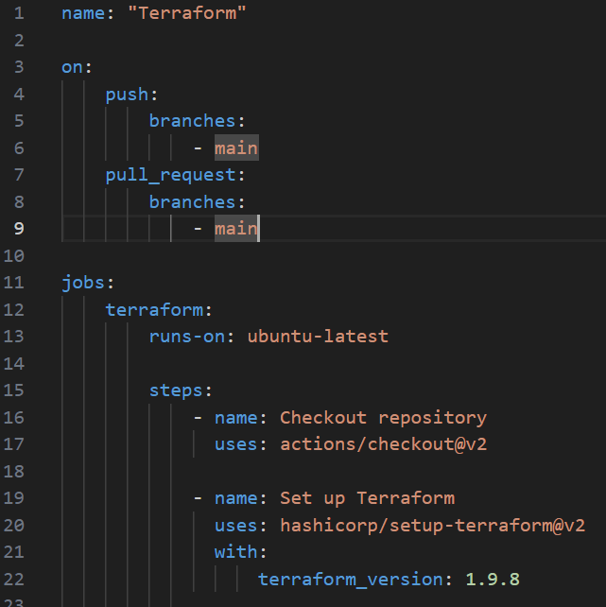

Slide 45
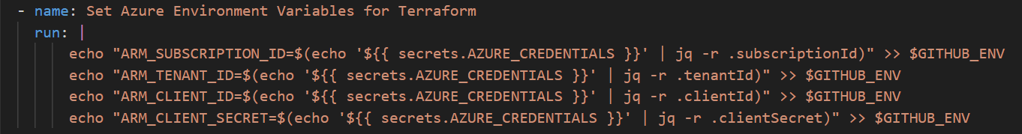

Slide 46
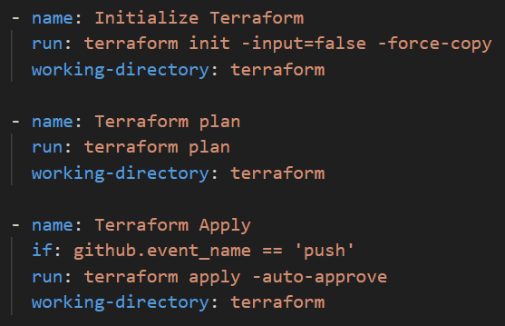

Slide 47
React CI/CD
When terraform has completed we can run the React CI/CD pipeline.

Slide 48
React CI/CD
For React we use the following steps:
Run pipeline when Terraform has finished
Checkout repo
Install packages and run production build
Log into Azure Key vault and Azure Container Registry.
Build and push the docker container.

Slide 49
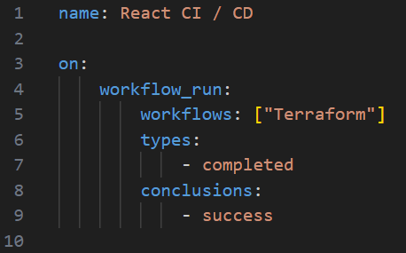

Slide 50
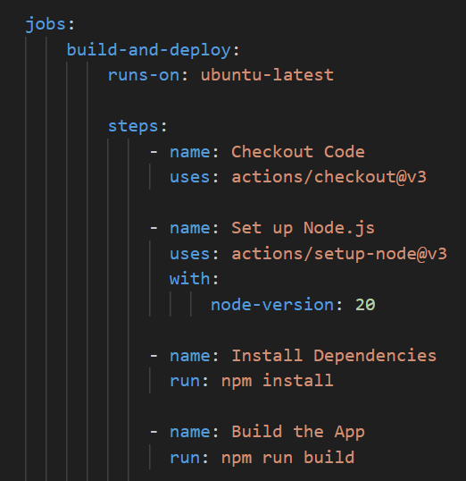

Slide 51
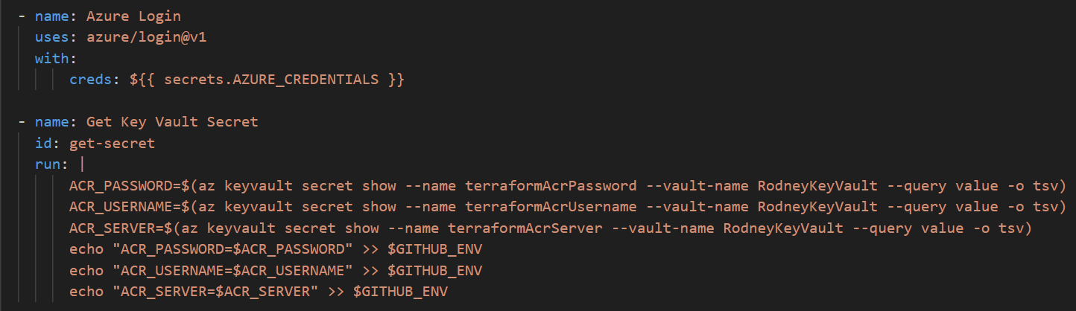

Slide 52
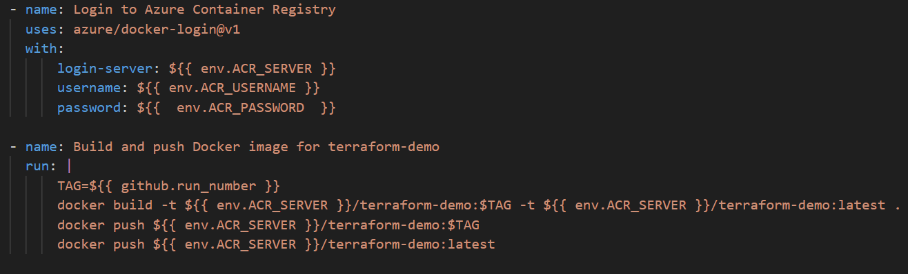

Slide 53
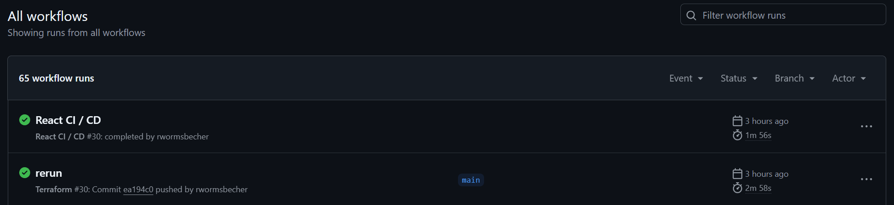

Slide 54
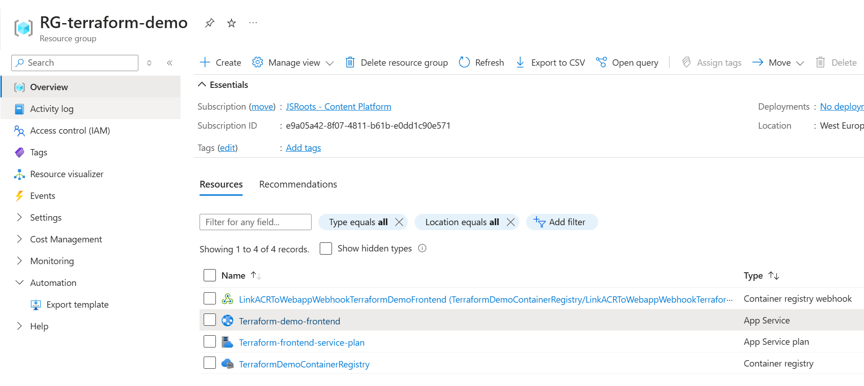

Slide 55
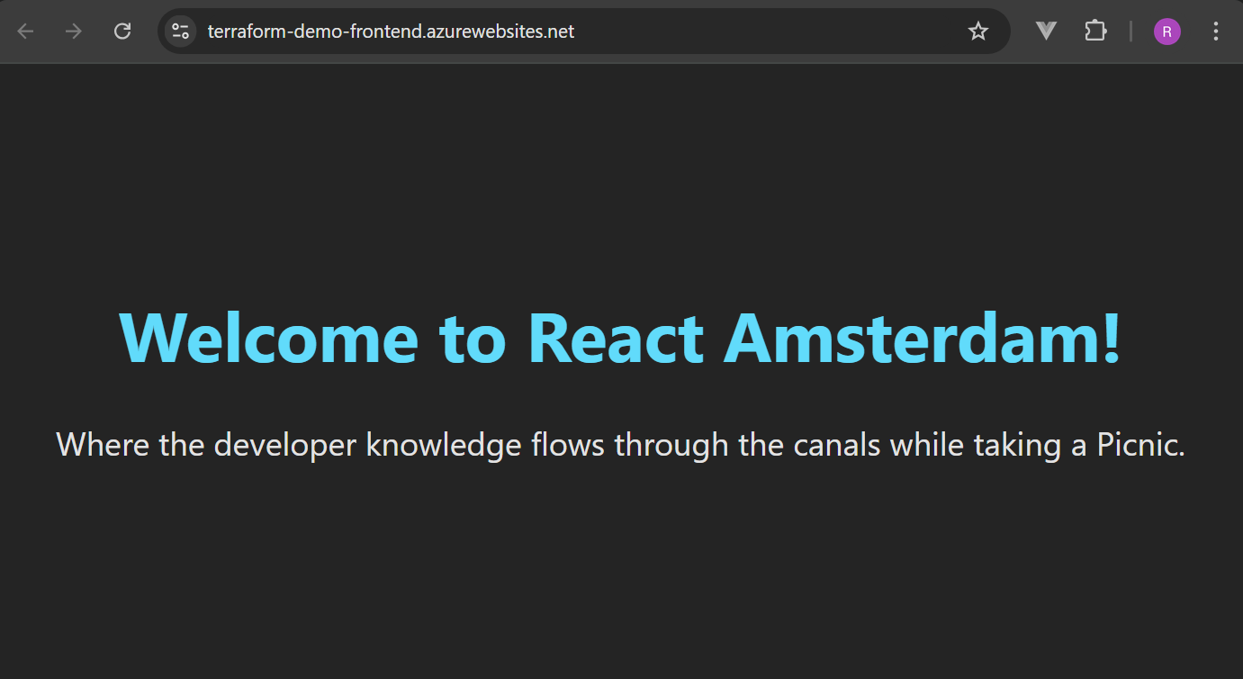

Slide 56
Summary

Slide 57
Tips & Tricks
Some last pointers before we part:
Terraform supports multiple files to organize code.
Terraform supports variables and for loops
By utilizing Docker, Kubernetes and Terraform, you are truly platform independent.

Slide 58
Thank you

Slide 59

Rodney Wormsbecher @ Ordina a Sopra Steria Company
https://www.linkedin.com/in/rocodemy

